Slide 1
Devops Test Automation
DevOps Test Automation refers to the practice of using automated tools and processes to streamline and improve the testing phase in a DevOps environment.
DevOps is a set of practices that aim to integrate and automate the processes of software development and IT operations, with the goal of delivering software more efficiently and reliably

Slide 2
Devops Test Automation
DevOps automation is the addition of technology that performs tasks with reduced human assistance to processes that facilitate feedback loops between operations and development teams so that iterative updates can be deployed faster to applications in production.
DevOps is designed for speed and flexibility, with automation complementing the process to make DevOps even faster and more responsive.

Slide 3
Why is Automation Testing Required?
Before releasing the product, the company must find any issues to guarantee a seamless consumer experience.
The testing team carries out various functional and non-functional testing procedures to ensure the overall product's reliability, effectiveness, and enhanced user experience.
Although testers do both manual and automated testing, automation testing requires less human labor and yields more reliable results.

Slide 4
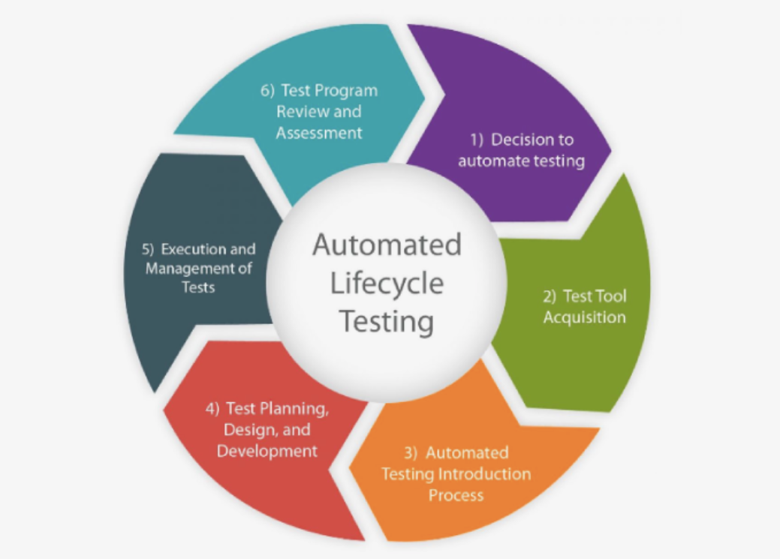
Process of Automation Testing

Slide 5
Test Tool Selection
For automation to be successful, selecting the appropriate tool based on the type of test involved is crucial.
Choosing the appropriate tools for code-driven testing, process-based testing, or graphical user interface-based testing is necessary.

Slide 6
Define the Scope of Automation
The scope of automation testing refers to the portion of your Application Under Test that will be automated. The following elements determine the scope -
The factors that are essential to the business's success
scenarios with a large amount of data
Shared features between several apps
Possibility from a technological perspective
The proportion of recycled business components

Slide 7
Planning, Design, and Development
Automated test would do after deciding on the aim and the testing type to automate.
First, break down the test cases into smaller, logical tests. Next, create test scripts and test suites, which are run sequentially through automation.
This is produced by building a test in a framework similar to a library with numerous test cases.

Slide 8
Test Execution
Automation Scripts are run in this stage. The scripts require test input before they can be set up to execute.
After running, they produce thorough test findings.
The test management tool can launch the automation tool or be utilized directly.
A detailed report on each test must be made after the final execution for other tests to use the report as a reference.

Slide 9
Maintenance
Each cycle requires new, updated, and maintained automation scripts.
For instance, after writing code, we check it to see if there are any bugs or if any failure happens.
As a result, we locate the problematic code section, correct it, and run the entire program from scratch.
Therefore, maintenance is crucial, which improves the necessity of automation scripts.

Slide 10
Types of Automation Testing
1. Smoke Testing
Because this test assures that the software is secure to be evaluated further without the risk of starting a fire, it is known as a "smoke test."
Smoke tests are used to check the stability and functionality of the software.
If the application doesn't meet that standard at this stage, it should be returned to the development team.

Slide 11
2. Unit Testing
As its name suggests, this step involves testing each of the software's separate parts or pieces.
The very first stage of testing, known as unit testing, is typically carried out manually by developers before sending the product to testers, while it is also possible for it to be automated.

Slide 12
3. Integration Testing
The main goal of integration testing is to evaluate the various components and modules of the program as a whole.
It determines whether each software integration satisfies the solution's functional requirements
This testing procedure examines the interactions between each integration.

Slide 13
4. Functional Testing
A type of software testing known as functional testing verifies a software system against functional specifications and requirements.
Each function of the software program is tested using functional tests, which involve supplying the right input and comparing the output to the functional requirements.

Slide 14
Test Automation stages
Unit testing: validates individual units of code, such as a function, so it works as expected
Integration testing: ensures several pieces of code can work together without unintended consequences
End-to-end testing: validates that the application meets the user’s expectations
Exploratory testing: takes an unstructured approach to reviewing numerous areas of an application from the user perspective, to uncover functional or visual issues

Slide 15
Test Automation Tools
https://saucelabs.com/resources/blog/top-test-automation-frameworks-in-2023
Use the above link o read some test au in Devops automation tools

Slide 16
Automation to workflow
https://www.youtube.com/watch?v=68XLP0ayjPA
Use this video to integrate automation test in Jenkins Pipeline

Slide 17
Devops Deployment Automation
What is it and how to start. Deployment automation uses software tools and systems to move code changes from one software environment to another, eliminating the need for manual software releases.

Slide 18
Benefits of deployment automation
Speed and Efficiency: Automation reduces the time required to deploy software significantly.
Consistency: Automated deployments ensure consistency across environments.
Improved Collaboration: Automation encourages better collaboration between development, operations, and quality assurance teams.
Compliance and Auditability: Automated deployments can enhance compliance with regulatory requirements and improve auditability.

Slide 19
Principles of deployment automation
Deployment automation is guided by several principles that aim to streamline and enhance the efficiency, reliability, and scalability of software deployment processes.

Slide 20
Infrastructure as Code (IaC):
This principle involves defining and managing infrastructure (servers, networks, databases, etc.) through machine-readable files or scripts.
Using tools like Terraform, CloudFormation, or Ansible, teams can automate the provisioning and configuration of infrastructure, ensuring consistency and repeatability across environments.

Slide 21
CI/CD:
CI/CD practices involve automating the build, testing, and deployment processes for software applications.
By integrating these processes into a pipeline that runs automatically upon code changes, teams can accelerate the delivery of new features and updates while maintaining high quality through automated testing.

Slide 22
Blue-green deployment
Blue-green deployment is a technique used in software deployment strategies to minimize downtime and reduce risk during releases.
The concept involves having two identical production environments, typically named "blue" and "green.

Slide 23
How it work?
Setup:
Blue Environment: This is the current live production environment serving user traffic.
Green Environment: This is a duplicate of the blue environment but remains idle (not receiving live traffic).

Slide 24
Cont’d
2. Deployment Process:
Initially, all user traffic is routed to the blue environment, which is the active production environment.
When a new version of the application or service is ready to be deployed, it is deployed to the green environment.

Slide 25
Cont’d
3. Testing:
After deployment to the green environment, thorough testing and validation are performed to ensure that the new version behaves correctly and meets performance benchmarks.

Slide 26
Cont’d
4. Switching Traffic:
Once the green environment is verified to be functioning correctly, traffic routing is switched from the blue environment to the green environment.
The green environment now becomes the active production environment, handling all user traffic.

Slide 27
Cont’d
5. Monitoring:
Monitoring and testing continue after the switch to the green environment to detect any issues that may have been missed during initial testing.
If any problems are detected, traffic can quickly be switched back to the blue environment (rollback).

Slide 28
Cont’d
6. Post-Deployment Cleanup:
After successful deployment and stabilization, the blue environment can be updated with any necessary configuration changes or database schema updates to match the green environment.

Slide 29
Canary Deployments
Canary deployments are another deployment strategy used in software release processes, focusing on minimizing risk by gradually rolling out new features or updates to a subset of users before deploying them widely.

Slide 30
Canary Deployments
Initial Deployment:
A new version of the application or service is deployed to a small subset of users or servers, often referred to as the "canary group" or "canary environment.“
Monitoring and Evaluation:
During the canary deployment, the performance, stability, and user feedback of the new version are closely monitored. This includes metrics like error rates, latency, and user interactions.

Slide 31
Canary Deployments
Gradual Rollout:
If the canary deployment is successful and no critical issues are detected, the new version is gradually rolled out to an increasing percentage of users or servers.
Validation and Feedback:
Throughout the rollout process, continuous validation and feedback collection help ensure that the new version meets expectations and performs as intended.

Slide 32
Canary Deployments
Completion or Rollback:
Depending on the results of monitoring and feedback, the deployment can be fully completed across all users or rolled back to the previous version if issues are detected.

Slide 33
Deployment Automation Tools
https://www.functionize.com/automated-testing/best-automated-deployment-tools
Use the above to explore the deployment tools

Slide 34
Cont’d
https://www.jenkins.io/doc/pipeline/tour/deployment/
https://www.youtube.com/watch?v=KHnQ0n4deqI
Use the above link to learn automated deployment deployment

